Slide 1
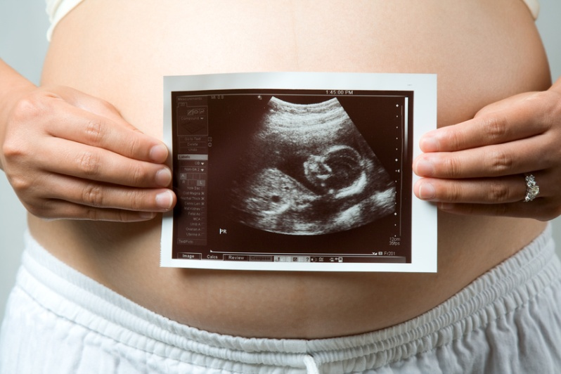
Obstetrical and Gynecological Emergencies
By Justine Jewell RN BScN ENC(C)
Clinical Educator VH AED
Revised by Alison Armstrong RN ENC(C) 2012 & 2014

Slide 2
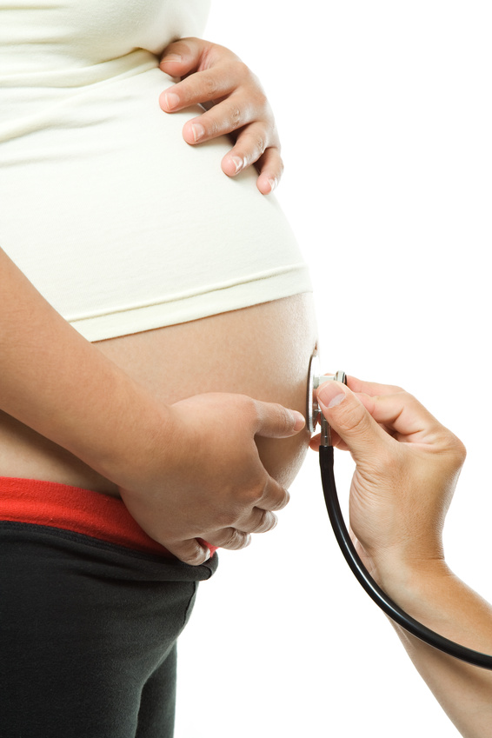
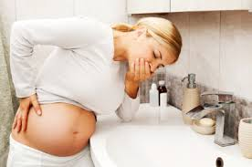
Obstetrical Emergency Patient

Slide 3
OB-Common Presentations to the ED
Vaginal bleeding in early pregnancy
Vaginal bleeding in late pregnancy
Ectopic pregnancy
Pregnancy induced hypertension (PIH)
Hyperemesis gravidarum
Post partum hemorrhage
Emergency delivery
Trauma in pregnancy

Slide 4
How to take a history?
Date of LMP & whether it was normal.
Calculate gestational age (wheel) or (1st day LMP –3 mos.+7days)
GTPALS
Gravida-number of times pregnant
Term- number of babies born at term(>37 wks)
Preterm-number of babies born preterm(<37 wks)
Abortions- therapeutic or spontaneous <20 wks
Living- number of living children
Stillborn- born dead.

Slide 5
History cont’
Pain assessment (location, description, duration, onset)
Vaginal bleeding (timing, amount, +/- clots/tissue)
Anyone 20 weeks or greater gestational age is sent directly to Delivery triage. (VH only….and if complaint corresponds with pregnancy)

Slide 6
Assessment
Vital signs- including posturals
FHR- can be detected by bedside doppler techniques as early as 10 weeks (if you’re really good)
Abdominal inspection-inspect, auscultate, palpate, percuss
Uterus is palpable at the level of the symphysis pubis at 12 weeks and at the level of the umbilicus at 20 weeks.
Assess for vaginal bleeding- onset, amt., colour, clots or tissue.
Notes:
Auscultate-bowel sounds may be faint, tympanic or heard higher up in chest
Palpate- tenderness, size of uterus

Slide 7
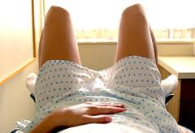
Interventions
Blood work (CBC, BHCG, Group & Reserve)
Intravenous if indicated
Pelvic Exam- assist MD

Slide 8

Careful!!!!
All female patients between the age of 11-55, presenting with abdo pain and/or vag bleeding should have a BHCG.
In one ED study, 11.5% of women who said there was “no chance I could be pregnant” had positive pregnancy results.

Slide 9
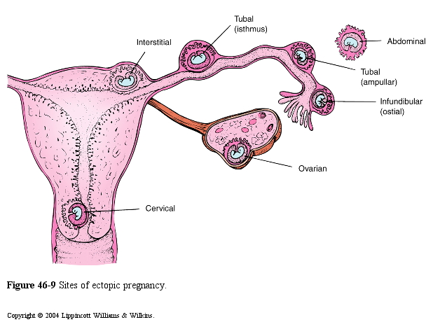
Ectopic Pregnancy
Implantation of a fertilized ovum in any tissue other than the lining of the uterus.
Most common site (90%) is the distal 2/3 of the fallopian tube, frequently on the maternal right side.

Slide 10
Causes
Prior tubal infection
Congenital tubal abnormality
IUD’s
Previous abdominal surgeries with adhesions
Fluctuations in regular cycle
Tubal ligations

Slide 11
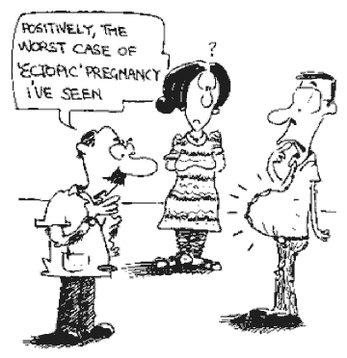

Slide 12
Signs and Symptoms
Bleeding (may be intermittent or absent if blood is spilling into the peritoneal cavity)
Low abdo pain
Kehr’s sign- suggestive of free fluid in the peritoneal cavity (referred pain to shoulder)

Slide 13

Diagnosis
Clinical picture
BHCG (will be low for dates)
Pelvic exam
U/S

Slide 14
Treatment
Maintain ABCs
Hemodynamic monitoring
Fluid management
Pain management
Surgical intervention or methotrexate
Grief management

Slide 15
Abortion
Abortion refers to the termination or loss of pregnancy before viability of the fetus (<20 weeks).
There are 3 types of abortions:
Missed, therapeutic or spontaneous.

Slide 16

Note
20-25% of all women experience some bleeding during pregnancy.
50% who have bleeding in early pregnancy miscarry.
80% of miscarriages occur in the first 12 weeks, the rest occur before 20 weeks.

Slide 17
Causes
abnormal embryo/zygote
maternal infections
endocrine defects
malnutrition
substance abuse
immunology incompatibility (RH -)
surgery in pregnancy
structure anomalies
10-15% of known pregnancies end in spontaneous abortion, true incidence is unknown.

Slide 18
S & S
Vaginal bleeding +/- clots
Cramping
Loss of pregnancy symptoms

Slide 19
Diagnosis
History
BHCG (serial)
Pelvic exam
U/S (sometimes)

Slide 20
Abortions
TYPES
BLEEDING
PAIN
CERVIX
UTERUS
Threatened
Yes
Not always
Closed
Average for dates
Inevitable
Yes
Yes
Open
Average for dates
Incomplete
Yes
Yes
Open
Smaller than dates
Missed
Yes
Not always
Closed
Smaller than dates

Slide 21
Treatment for Inevitable, Incomplete or missed abortion
Volume management
Oxytocin if ++bleeding
Rhogam if mother is RH negative
Grief Management
*Depending on the number of weeks gestation, amount of bleeding and cramping, an Ob/Gyn may be consulted for a D&C.

Slide 22

Treatment for Threatened Abortion
BHCG repeat in 2 days
50/50 chance pt. will still miscarry
Note
A small amt. of bleeding can occur at the time of endometrial implantation.
Bleeding may also occur after intercourse.

Slide 23
Discharge Instructions
Return to ED if increased bleeding, pain, or fever
Follow up with family doctor for serial BHCGs
Anticipate referral to EPAU.
Avoid tampons and intercourse because of risk of uterine infection
Grief counseling may be needed!

Slide 24

Hyperemisis Gravidarum
Severe vomiting occurring before the 20th week of pregnancy.
Possible causes
-B6 deficiency
-Impaired adrenal cortex function
-Hyperthyroidism
-Excess BHCG secretion
-Psychological factors
-Alterations in gastrointestinal physiology
-Poor nutrition

Slide 25
Treatment
IV fluids
Anti-emetics
Gradual oral rehydration
D/C Instructions
-oral fluids as tolerated, small frequent meals, take meds as directed, return to ED if continues, moderate activity.

Slide 26

EMERGENCY CHILDBIRTH

Slide 27

EMERGENCY CHILDBIRTH

Slide 28
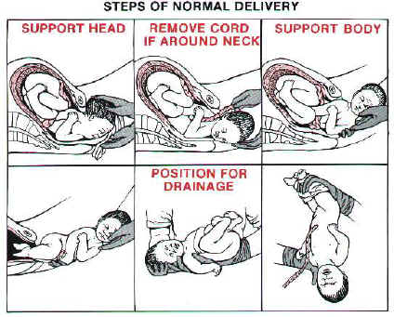
Emergency Childbirth

Slide 29
Emergency Childbirth
Steps in Emergency Delivery
Place the mother on her left side to slow fetal descent
Have the mother open her mouth and pant to slow progress
Have suction equipment, a neonatal resuscitation bag and oxygen supply available
Use universal precautions
Ease the perineum back until the head emerges.

Slide 30
Emergency Childbirth cont’
As the baby’s head emerges, check for the umbilical cord.
Suction the baby’s mouth first, then the nose.
Support the baby with both hands. Do not pull the baby out, allow the baby to advance on its own. Instruct the mother to bear down with contractions. Apply gentle downward pressure on the baby’s head until the anterior shoulder is visible. Then upward pressure as you lift out the posterior shoulder.
Keep the baby’s head lower than its trunk to promote drainage.
Double clamp & cut the cord.

Slide 31
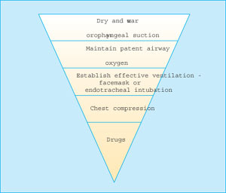
Infant Care
Assess and support-Temp, ABC
Frequently needed-dry, warm, position, suction, stimulate, oxygen
Infrequently needed- ventilation assistance, chest compressions, medications

Slide 32

Signs of Placental Separation
Dark blood gushing from vagina
Lengthening of the umbilical cord
Uterine fundus rising upward in the abdomen or becoming more firm
Ask Mom to bear down with a contraction to expel the placenta. Massage the uterus to help it contract.

Slide 33
Pregnancy Induced Hypertension (PIH)
PIH occurs in 10% of all pregnancies.
The cause of PIH is unknown, however the primary underlying mechanism appears to be vasospasm. Vasospasm impedes blood flow through the arterial system affecting major organs (brain, lungs, liver, kidneys, placenta, eyes).

Slide 34
Eclampsia
new onset of grand mal seizure activity and/or unexplained coma during pregnancy or postpartum in a woman with signs or symptoms of preeclampsia.
clinical manifestations of maternal preeclampsia are hypertension and proteinuria
occurs during or after the 20th week of gestation or in the postpartum period
Features of eclampsia include the following:
Seizure or postictal state
Headache, usually frontal
Generalized edema
Vision disturbance, such as blurred vision and photophobia
Right upper quadrant abdominal pain with nausea
Amnesia and other mental status changes
Eclamptic convulsions are life-threatening emergencies and require the proper treatment to decrease maternal morbidity and mortality. Delivery is the only definitive treatment for eclampsia.

Slide 35
Treatment for Eclampsia
Eclamptic convulsions are life-threatening emergencies and require the proper treatment to decrease maternal morbidity and mortality. Delivery is the only definitive treatment for eclampsia.
A pregnant patient who has been involved in an unexplained trauma (such as a single-vehicle auto accident) and has exhibited seizure activity should be evaluated for eclampsia.
http://emcrit.org/wee/peri-mortem-c-section/

Slide 36
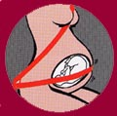
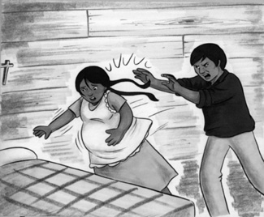
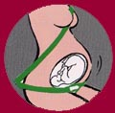
Trauma In Pregnancy

Slide 37
Trauma and Pregnancy
Trauma is the primary cause of mortality during pregnancy, accounting for up to 22% of all maternal deaths.
Most common is blunt trauma as a result of MVCs
Mechanisms include
-falls, burns, inhalation injuries, firearm, stab wounds and domestic violence.

Slide 38
The most critical principle in patient management is the direct attention toward maternal well-being.

Slide 39
Diagnostics
Mom-CBC, lytes, blood type and RH, Coagulation profile, Kleihauer-Betke test, urinalysis, tox screen, ABG, ECG, CT, x-rays, DPL, U/S
Baby-cardio topographic monitoring (FHR and uterine contractions)
Notes:
Kleihauer-Betke test-detection of fetomaternal hemorrhage

Slide 40
Plan/Interventions
Depends on significance of injury
All pregnant trauma patients should be monitored for a minimum of 4 hours.
Return to ED or L/D unit for
-abdo cramping or contractions
-decrease or lack of fetal movement
-vaginal bleeding
-leakage of amniotic fluid
-dizziness and syncope

Slide 41
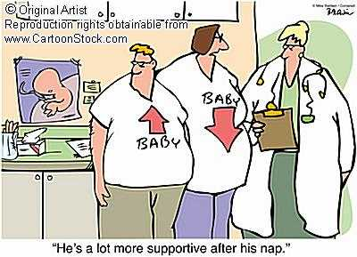

Slide 42

Gynecological Presentations

Slide 43
GYN-common presentations to the ED
Vaginal bleeding/dysfunctional uterine bleeding
Pelvic pain
Vaginal discharge
STIs (sexually transmitted infections)
PID (pelvic inflammatory disease)
Sexual assault

Slide 44
Vaginal Bleeding
Causes (non-pregnant pt)
-uterine fibroids
-menstrual cycle irregularities
-trauma
-infection
-malignancy
-coagulopathey
- DUB-dysfunctional uterine

Slide 45
DUB
Dysfunctional Uterine Bleeding
-results from hormonal imbalance
-occurs secondary to anovulation (beginning or end of reproductive years)
-characterized by: steady, painless bleeding and the absence of clots or tissue

Slide 46
Assessments
General assessment
Orthostatic VS
Inspect, auscultate, percuss, palpate the abdomen
Pelvic exam: abnormal vaginal d/c, cervical motion tenderness, adnexal tenderness

Slide 47
Assessment and Diagnostics
CBC, BHCG, Coags, Thyroid function tests, LFT’s, Group and cross, U/A, STI screening
U/S
Gyne referal

Slide 48
Pelvic Pain
Causes
-any condition originating in the lower abdomen
-referred from adjacent body regions
-distention of the capsule of a solid organ
-stretching of pelvic ligaments or adhesions
Classified as Acute, Chronic and Recurring

Slide 49
Diagnostics
CBC, ESR, C-reactive protein, lytes, blood cultures, BHCG, U/A, STI screening
U/S
CT abdomen
Diagnostic laparoscopy

Slide 50
Vaginal Discharge
Most common causes
-Bacterial vaginosis (40-50%)
-Candida Albicans (20-25%)
-Tichomonas (15-20%)
May be normal physiological phenomenon for women of all ages

Slide 51

STI’s
Primary infections include:
-neisseria gonorrhea
-chlamydia trachomatis
-treponema pallidum (syphilis)
-bacterial vaginosis
-condyloma acumination (venereal wart)
-herpes simplex virus
-HIV

Slide 52
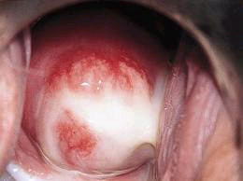
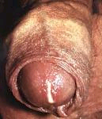
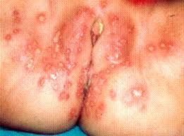
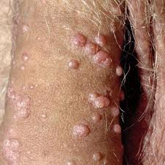

Slide 53

Complications of STI’s
Vaginitis
Cervicitis
PID
Urethritis
Epididymitis
Pharyngitis
Proctitis
Skin and mucous membrane lesions
HIV/AIDS

Slide 54
PID (Pelvic Inflammatory Disease)
Term used to describe an infection of
-endometrium, fallopian tube, ovaries, pelvic peritoneum, pelvic connective tissue.
Most common causes-chlamydia and gonorrhea

Slide 55
Complications of PID
Tubal damage resulting in infertility
Chronic pelvic pain
Dyspareunia
Risk for ectopic pregnancy

Slide 56
Predisposing risk factors to PID
Adolescents
Multiple sexual partners
High frequency of intercourse
Exposure to STI’s
Nonbarrier contraception
IUD’s
Recent gynecological procedures
Douching
smoking

Slide 57
Assessments
Fever
Tachycardia
Lower abdo pain, rebound tenderness
Pelvic exam: abnormal vaginal discharge, cervical motion tenderness (chandelier sign), adnexal tenderness

Slide 58
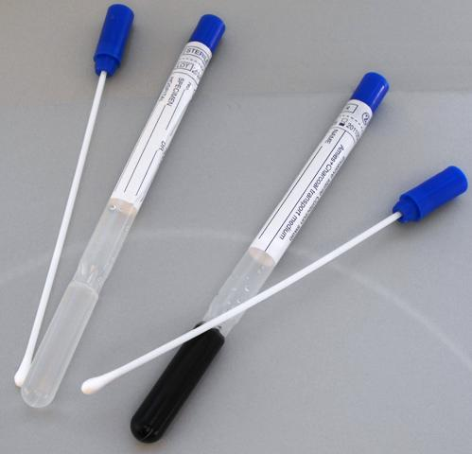
Diagnostics
CBC, ESR (elevated), C-reactive protein (elevated), lytes, blood cultures, BHCG, U/A, cervical cultures and gram stain
Pelvic U/S
Ct abdomen
Diagnostic laparoscopy

Slide 59
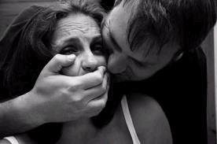
Sexual Assault
Common violent crime that can occur to children, women and men
Estimated 80-90% of all cases go unreported

Slide 60
Question
Are you safe at home?
Have you ever been slapped, hit, grabbed or threatened?

Slide 61
Assessments
Physical exam and evidence collection should occur within 72 hours ideally but also up to 1 week post assault.
St. Joe’s Sexual Assault/DV team
History
-Date, time and place of assault
-Description of assault, # of assailants, weapons used, type of assault, use of barriers
-Associated injuries
-Post assault activity (urination, change of clothing, showering, etc.)

Slide 62
Diagnostics
BEST to get the Sex Assault team to the bedside!
BHCG
HIV, Hep B
STI screening
Other lab/rad studies as indicated

Slide 63
Treatment
Prophylactic STI treatment
Pregnancy prevention (ovral, estradiol)
Psychosocial counseling
HIV counseling and testing

Slide 64
Questions?

Slide 65
References
EMCRIT website http://emcrit.org/wee/peri-mortem-c-section/ accessed May 7th, 2014
Ross, M., Ramus R. (2013) “Eclampsia” Medscape Online accessed May 7th, 2014
RNAO http://rnao.ca/sites/rnao-ca/files/BPG_Woman_Abuse_Screening_Identification_and_Initial_Response.pdf

